Slide 1
Back to Netball
Tyne & Wear
Welcome to the first ever Back to Netball Newsletter!
Here is a roundup of some exciting up and coming events over the next few months and how you can get involved.
#backtonetball
Inside: England v Malawi; Christmas tournament; Team Northumbria fixtures and much more…

Slide 2
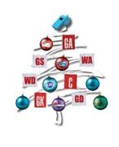
The big Christmas fancy dress extravaganza!
This year we will be running the Christmas tournament on Wednesday 17th December. We are lucky enough to be holding this at Sports central – the home of our NSL franchise, TEAM NORTHUMBRIA! £30 per team to enter.
To enter please contact your local NDO/NDCC. Spaces are limited to 10 teams so get your entries in quick!
Fancy dress compulsory!
Get Social..
Find us on Facebook (Back to Netball Newcastle) and Twitter (@B2NNewcastle)
Be the team….
Great news everyone! You can now get your hands on your very own Back to Netball t.shirt at only £7.50. Available in sml, med, lge. Perfect for training sessions! To get your own just email gemma.sandberg@englandnetball.co.uk

Slide 3
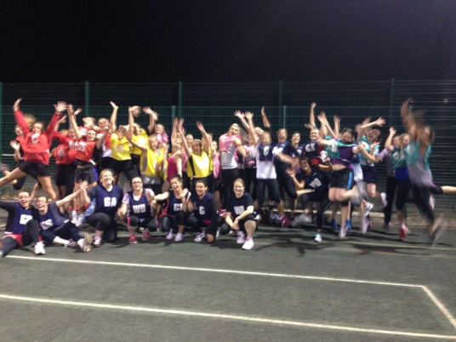
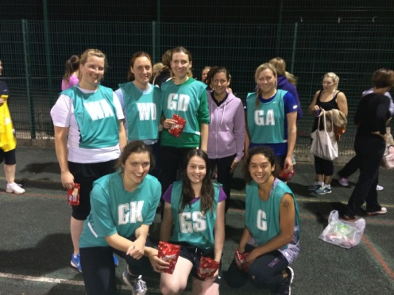
Congratulations!
A Back to Netball Tournament was held on 11th September at Walbottle Campus.
All teams were competing together for the first time, and it was the first tournament which the ladies had participated in. A big congratulations must go to the ladies who train at Gosforth Academy who entered 2 teams into the tournament with one team finishing in 3rd position and the other team finishing in 1st! Over the course of the evening, over £100 was raised for Cancer Research UK. A huge thank you and well done to all of the players!
England Netball’s partner charity is Cancer Research UK, a charity which is close to the hearts of thousands of people around the country.
If you have any suggestions for future sessions, or would like to share your thoughts, we’d love to hear from you! Contact gemma.sandberg@englandnetball.co.uk

Slide 4
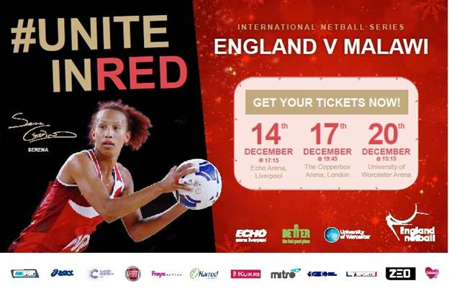
#uniteinred this December
Make sure you’re part of the crowd representing the North in Liverpool this December as England take on Malawi
Get your tickets here
Superleague returns to the North East in 2015!
Team Northumbria are big players in Netball, competing in both of the UK’s premier Netball Performance League and Netball Superleague competitions. They are the North East’s only top flight Netball Superleague team and finished 6th in the league in 2014. Tickets available via sky tickets

Slide 5
New Back to Netball session
Starts Thursday 6th November
Find your nearest session here

